Slide 1

ROBUST
Unlocking Rural-Urban Synergies
Rural England Stakeholder meeting with UK RPPRG
Daniel Keech, Damian Maye and Matt Reed
University of Gloucestershire
dkeech@glos.ac.uk
London 16th January 2020
ROBUST receives funding from the European Union’s Horizon 2020
research and innovation programme under grant agreement No 727988.

Slide 2
Overview
Description of the ROBUST project, partners, objectives.
Methodology - experimentation in governance: Living Labs
Two examples of work-in-progress from Gloucestershire
  School food procurement contract
  Natural Flood Management
Concluding remarks on urban-rural synergies
www.rural-urban.eu

Slide 3
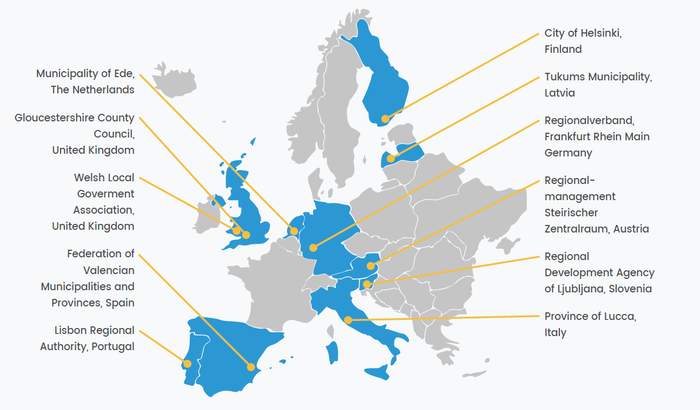
ROBUST partnership
Notes:
This slide shows each of the 11 geographically distributed Living Labs.
As well as being widely dispersed across Europe, they are very different areas. For example, Mid-Wales, Ede and Tukums are rural regions with few small towns. Helsinki, Ljubljana and Lisbon are capital cities. Frankfurt-Rhein-Main is a region of 72 local councils of which only one (but the largest and economically dominant) is Frankfurt. Valencia has a similar profile, with a large rural area and an economically dominant city.
In each case, two partners – a research partner and a municipal partner – run the LL between them.
All partners are trying to improve the governance of urban-rural relationships, usually because policy attention is regionally unbalanced, or because of ways of life which affect territorial cohesion (for example Helsinki’s multi-locational residency, Estonian commuting and Finnish high-tech relocations out of the city).

Slide 4
ROBUST objectives
ROBUST examines the way that rural and urban areas are synergistically linked, e.g.
  Proximately – rural to urban commuting; ESS such as flood risk mitigation or biodiversity in countryside around cities; food production and supply chains.
  Distal – international tourism; global trade.
How are these relationships governed? Who is involved in that? Can governance be optimised in order to enhance job opportunities?
Governance challenges and opportunities
  Network governance
  Smart growth (‘…prioritising what a local economy can do best.’ Woods and Heely 2019).
  New Localities
Notes:
Governance challenges
Democratic mandates are territorially restricted
Austerity in public finances (bigger role for market? e.g. PES?)
Competing evidence (e.g. nutrition) and unpredictable future (e.g. climate)
Effectiveness of governance instruments (e.g. S106, FR grant-in-aid)

Slide 5
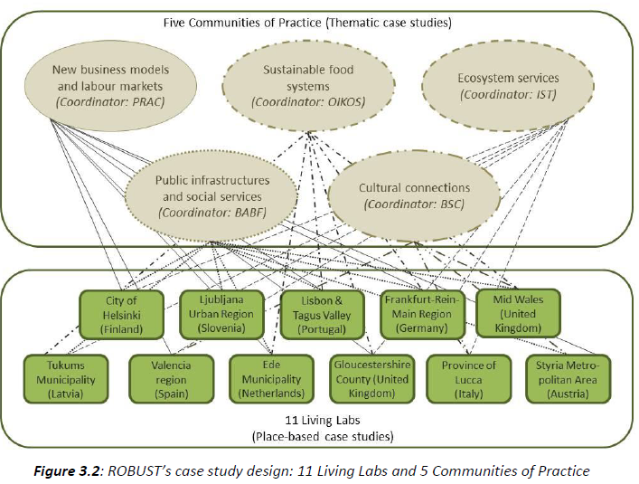
LL and CoP interactions
Notes:
In this slide the two main aspects of the ROBUST methodology are presented and connected.
Each LL chooses to specialise within three of five thematic areas.
For example, in Gloucestershire, our LL will think about the governance of rural-urban interactions and synergies in relation to ESS, sustainable food and new business models (in effect we are examining CE approaches to growth).
In addition to this, we join all the other LLs who have selected these themes in Communities of Practice. The CoPs are led by academic partners and agree a programme of inquiry which are help answer common theme concerns.
For example, in the CoP for ESS, we are looking at five distinct research areas: the role of the private sector in PES; multi-scale planning (ie local to regional integration); ESS mapping and bundling; circular farming; community partnerships. These areas of research respond to and inform priorities raised in the LLs.

Slide 6
Experimental governance
EG is ‘based on framework rule-making and revision through recursive review of implementation experience in different local contexts … It as a recursive process of provisional goal-setting and revision based on learning’ (Sabel and Zeitlin 2011: 3).
EU regulation and the Water Framework Directive
Experiment with ‘governance innovations’ and the potential for change
This is, essentially, the basis for our Living Labs in ROBUST

Slide 7
Living Labs
Historical origin: user-driven ICT systems development
No uniform definition: partnerships; demonstrations …
“[A]n arena (i.e. geographically or institutionally bounded spaces), and as an approach for intentional collaborative experimentation of researchers, citizens, companies and local governments” (Voytenko et al. 2016: 46).
Urban living labs: a form of collective urban governance and experimentation
I.e., experimental governance and not just technology-focused (issues of behaviour, consumption, etc.)

Slide 8
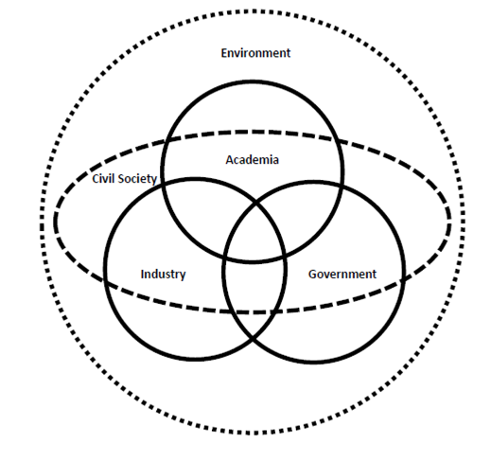
Living Labs: key characteristics
Geographical embeddedness
Experimentation and learning
Participation and user involvement
Leadership and ownership
Evaluation and refinement
(Voytenko et al., 2016)
Quadruple helix model of innovation

Slide 9
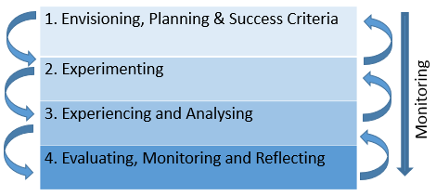
Living lab stages
Notes:
General characteristics formulated as four stages per lab …
1. Envisioning
Understand stakeholder needs
Decide LL goals
Develop and refine our Research and Innovation Agenda (RIA)
2. Experimenting
Experimentation can include testing new technologies (traditionally what LLs were about) and ideas/solutions (technical and social) in real world contexts.
The objective is to co-produce knowledge and ideas with users; i.e. user-centred experimentation e.g. field visits, competency group meetings, exchange visits which lead to ideas for new or improved institutional arrangements.
3. Experiencing and Analysing
Deepening the analysis in the experiment(s) in a ‘real world’ context to further inform the learning/viability e.g. via interviews with professionals/regulators to assess opportunities/bottlenecks for change to the system/regulations; trends analysis; collecting opinions; shadowing officials.
4. Evaluating, monitoring, reflecting
On-going throughout the LL process in order to refine it as necessary.
As well as doing this at a LL level, we also have a PhD student based at Uni Pisa who is evaluating the LL process in the project as a whole.

Slide 10
Examples
Living Lab | Motto/theme | Concepts used | Intended outcomes
Ljubljana | Functional collaborative partnership to co-design and operate short food supply chains in Ljubljana’s rural-urban relations. | Short food supply chains. | Localisation of the food procurement service in the region through municipal and food chain collaboration.
Lucca | Developing a local food policy and a territorial plan to reduce urban sprawl, steer synergies between the city and the countryside, and valorise cultural heritage, landscape and territory. | Spatial planning. | Optimised strategic approach to managing urban sprawl and the enhancement of rural vitality. Establishment of food council.
Mid-Wales | Polycentric growth without an urban hierarchy. | Relational space, dispersed rural-urban links. | Cross-municipal collaboration in pursuit of smart development.
Gloucester-shire | To assess the potential and feasibility of circular economy and natural capital growth models in the county and their potential for synergies and improved urban-rural linkages. | Circular Economy, natural capital. | To identify and promote CE and NC approaches in emerging industrial, waste, agricultural and spatial policies.
Tukums | Developing a cultural strategy for the municipality by identifying key development objectives and priorities. | Cultural heritage. | Development of cultural policy, increase in farmers’ markets, cultural e-platform and local food certification scheme.
Ede | Developing and integrating Ede’s municipal food, environmental and spatial planning policies, by formulating goals and using key indicators for monitoring its agri-food system and natural capital. | Natural capital. | New policy options leading to integrated decision-making across the territory.
Notes:
To give you all a glimpse of how we are implementing the LL approach:
Ede LL works on integrating municipal food, environmental and spatial planning policies;
Gloucestershire LL work relates to dynamic food procurement and circular economy;
Lucca LL works on Food Policy and territorial planning to reduce urban sprawl and valorise cultural heritage and landscape.

Slide 11
The Gloucestershire ‘Food Lab’
UoG and Gloucestershire County Council
New food strategy for Glos (led by RAU)
Other policy links: Gloucestershire 2050, Local Industrial Strategy, 25 Yr. Enviro Plan, etc.
Co-innovation but tangible outcomes
Areas of experimentation:
  School food contracts (dynamic procurement in new contract – develop a business case; sustainable diet);
  New business models (circular, smart, public, PESS)
Notes:
We are using the living lab concept, which is about co-innovation and experimentation, but we want to create tangible outcomes.
We are linking with the current work being led by the RAU to develop a new food strategy for the county.
Other county and national policy links too: Glos 2050, Local Industrial Strategy, Defra’s 25 Yr Environment Plan, Waste Strategy and Ag Bill and proposed food policy
Gloucestershire LL work relates to dynamic food procurement and circular economy
We would like to experiment in two main areas of food governance:
School public procurement, bearing in mind the current debate about ‘sustainable diet’ and less meat and also the potential to connect local farmers and schools (building on the Council’s already excellent procurement contract for schools and using Defra’s balanced scorecard criteria).
New business models for food, including circular food models, smart food models and possibly payments for ecosystem services (natural capital and water resource management – contracts to improve water quality, for example, as a public good).

Slide 12
Regionalising NFM
UoG, GCC, Stroud District, Local Nature P’ship, ES&W Reg Flood & Coastal C’tee
Currently NFM efficacy is limited or uncertain:
  ‘…it will never become more than a marginal part of flood risk management.’ (Wingfield et al. 2019)
Other policy links: Gloucestershire 2050, Local Industrial Strategy, 25 Yr. Enviro Plan, emerging Flood Risk Strategy, Green Infrastructure plans
Areas of experimentation:
  Re-articulating NFM as a rural-urban flood risk intervention, building on existing work in the Upper Thames
  Establishment of new NFM practioners’ network to cover (?) Hereford, Worcestershire, Gloucestershire, with a funded work programme
Notes:
Natural Flood Management has been championed in many quarters as a complementary intervention to more traditional, ‘hard engineering’ interventions such as constructing permanent flood defences.
NFM mimics natural processes and its techniques include adding woody debris (leaky dams) to watercourses to slow flows in times of flood, the introduction of beavers, soil conservation to reduce run-off, bankside habitat management including tree planting.
Because such natural interventions depend on many variables – local weather, local geology, maintenance – it is hard to accurately calculate the impact of NFM interventions beyond the immediate area.
But this doesn’t mean it can’t be tried or extended, and flood risk grant-in-aid is currently calculated on the basis on how many properties and people are protected.
Our hope is that ROBUST will facilitate – through various interviews and workshops - a much more holistic and territorially coherent (i.e. catchment-based) proposal for integrating NFM into a regional catchment management strategy, and establishing a network of NFM practitioners who would be responsible for implementing a range of interventions along catchments.

Slide 13
Concluding remarks – disruptive innovation?
In most cases, positive and constructive relations evident between practice-research partners and between LL teams and local stakeholders.
Political sensitivities and priorities influencing living labs
Targeted complementary social innovations
Tactics to ‘animate’ the lab (link with existing networks)
Living lab = triple or quadruple helix, i.e. co-production of knowedge. But the councils remain in control of decision-making. LLs are a way of informing governance decisions.
Disrupting the growth narrative? [IPCC 1.5°C report (2018); IPBES report (2019); EAT-Lancet (2019); Extinction Rebellion]
Notes:
Four general remarks:
It is clear that there are political sensitivities and local priorities which are influencing the lab work (RIAs are evolving). E.g. Lucca, Tukums, Glos, Ede
Teams are employing useful tactics / strategies to animate their lab. E.g. Ede (EPA and Food Policy Networks), Glos (Food Strategy and Local Industrial Strategy), Lucca (Food Policy work), Tukums …
Living labs are spaces of co-innovation with a minimum of triple and ideally a quadruple helix dynamic. Good examples: Frankfurt, Lisbon, Helsinki (NGOs).
Disrupting the growth narrative. ROBUST is really a project about growth. A huge debate now re ‘growth’ and challenging conventional growth thinking (Climate Change protests, Biodiversity, EAT-Lancet); the need for more synergistic frameworks (Doughnut Economics, Planetary Boundaries, Common Food Policy). Are we answering this agenda? How can ROBUST engage with these growth debates more courageously? For example, CE is a key part of the LIS but most economic development foresees ‘old’ rural-to-urban commuting, by motorway, with major new developments in the Severn Vale, which is at high risk of seas-level rise. Is there a danger that ROBUST’s pragmatism limits its radical innovation potential?

Slide 14
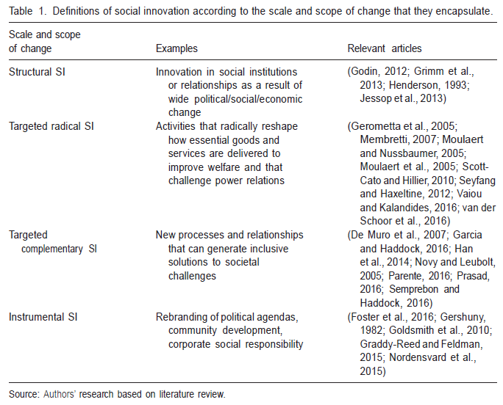
The scale and scope of innovation (Marques et al., 2018)
ROBUST
Notes:
Social innovations thus signify ‘acts of change’. The crucial aspect in this respect is the change in attitudes, behaviour or perceptions resulting in a new form of collaborative action. Social innovations are therefore non-material, with material outcomes (e.g. fresh food, farm machinery ring, a new community building or a community-owned wind turbine) being complementary to this; the focus is asset building, not needs (realisation). This concurs with the dimensions of social innovation identified by Kirwan et al. (2013), where capacities were given prominence.
Marques et al (2018) distinguish between four definitions of SI, based on the scale and scope of social change to which they are referring.
The first definition is structural definition, which is inspired by the writings of Max and Weber, and aims to interpret and explain wide ranging social transformation (democratic revolutions and the transition to capitalism in the C19th was a core concern of these scholars). Structural SI thus refers to the transitions that had to happen in the structures of society to trigger new economic and political systems. The term is now less common because of a tendency to favour more contextualised micro-analysis of social phenomena.
The second and third definitions are targeted radical SI and targeted complementary SI – these are the most commonly used over the last three decades.
Targeted radical SI aims ‘to change in a significant manner the way that certain good or services are produced and delivered’ (ibid., p 7); they challenge the status quo by addressing asymmetrical power relationships and include, for example, transition towns, grassroots community initiatives that aim to build sustainable living environments by reducing CO2 emissions and addressing inequality.
Targeted complementary SI describes activities that ‘seek to improve the production and delivery of certain goods and services, without radically reshaping current institutional arrangements or power structures’ (ibid., p. 8). There are echoes here to concepts such as the quadruple-helix and co-design, which emphasise broad participation. This type of SI refers to activities that aim to include end-users or citizens, in terms of the ‘design and delivery of goods and services, primarily those that are offered through, or with the support of the welfare state’. Again, they are circumscribed to certain domains (education or health), rely on their sector/community-based initiatives and are the product of specific national welfare regimes.
The final type, termed instrumental SI, highlights ‘the tendency of actors in the policy, practice and academic communities to rebrand existing activities and initiatives in line with the latest nomenclature, without fundamentally … altering their goals or outputs’ (bid., p 8). E.g. debates on community development, third sector activities or corporate social responsibility.

Slide 15

Thank you for your attention
dkeech@glos.ac.uk
www.ccri.ac.uk

Slide 16
1. Aim and objectives
Aim: to explore and analyse rural-urban relations and synergies in five thematic fields, across 11 case study areas.
Objectives:
To improve our understanding of both place-specific and thematic functional rural-urban linkages and their dynamics and determinants.
To identify and assess the potentials and bottlenecks for enhancing mutually beneficial relations between rural, peri-urban and urban areas in 11 diverse territorial settings.
To learn from sharing and comparing experiences from diverse rural-urban settings.
To reflect on the multi-method and multi-actor joint learning process of ROBUST.
Notes:
Objectives:
16

Slide 17
Innovation
Living labs = spaces of innovation and experimental governance. What does this mean in practice?
“[I]nnovation occurs when a new idea (or combination of old ideas) forms a different way of thinking or interacting” (Adams and Hess, 2008: 1).
Technological innovation
Social innovation
Incremental innovations
Radical innovations
Notes:
Innovation a buzzword in recent years. Adams and Hess (2008: 1) …
Two key distinctions. First, tech and social innovations:
TECHNOLOGICAL INNOVATIONS (examples would be consumer goods like the iphone or Dyson hoover. Examples within farming could be the tractor or bio-economic technologies such as GMO). Material, economic, technical, science and technology-orientated innovations. Marques et al: 2018): TI in three ways: one, implementation, as a new product, technology, idea or innovation that is implemented and generates value for a business; two, includes activities beyond product implementation; three, activities that happen within firms (i.e. private enterprise/economic value-added).
SOCIAL INNOVATIONS (everyday example might be changes in consumer behaviour e.g. carrier bags use, recycling behaviours, innovations in consumption practices). Talking then about changes in social practice in terms of attitude, behaviour, perceptions. Also be a change in the way society is governed – e.g. enable more civic involvement. Neumeier (2012) SI as: “[c]hanges of attitudes, behaviour or perceptions of a group of people joined in a network of aligned interests that in relation to the group’s horizon of experiences lead to new and improved ways of collaborative action within the group and beyond” (ibid.: 55). Marques et al 2018: SI is also about new ideas but distinct from TI in three ways: first, promotes inclusive relationships among individuals, especially those that are or have been neglected (SI thus values the process of implementing a new idea as much as it does the outcomes; second, it is about addressing need, whether in areas such as education or health or more broadly; third, SI is often aimed at specific domains: education, health and migration.
Innovation is central to transition processes; potentially ‘unlocks’ new styles of thinking.
Second distinction: incremental and radical. INCREMENTAL INNOVATIONS – These are also referred to as ‘first order’ innovations. Innovations (technological or social) that maintain the status quo; they don’t challenge the rules about how a system operates or how we behave as consumers/citizens. RADICAL INNOVATIONS – ‘second order’ innovations. Innovations that change the regime or system (organics); most likely to influence a regime when it is under pressure.

Slide 18
Living labs: application
LL = specific, concrete and context-focused
Applying the LL approach/principles (participatory development of innovative experimental solutions in place).
The living lab = a form of rural-urban collective governance and experimentation to address rural-urban linkages and smart growth in European regional territories.
We use the general characteristics to formulise common phases per LL.
Notes:
Each LL is specific, concrete and content focussed (as per the mission statements of each LL). We are applying the LL approach/its principles (i.e. participatory development of innovative solutions to enable rural-urban linkages/smart growth). Projects like URB@EXP and APRILab have done something similar (in urban contexts).
For ROBUST, the living lab is a form of rural-urban collective governance and experimentation to address rural-urban linkages and smart growth challenges in different European regional territories. The key characteristics are collaboration and experimental governance.
The focus in a LL is specific, concrete and content focussed – as per the LL mission statement/motto/overarching theme
Level of specificity in LL that cannot be achieved at CoP level because localities differ too much.

Slide 19
LL and CoP interactions
Notes:
The relation and interaction between LLs and CoPs is important.
“Mutual engagement and collective learning in CoPs should support the work in and of LLs (and not determine in). Interaction and exchange in CoPs is meant to improve developments and support innovations in LLs, simply because it enables the introduction of new perspectives, practices, approaches of other localities into the LL and through that it hopefully enriches learning and innovation in LLs.
Important to keep in mind, and maybe also to make the distinction between LLs and CoPs more explicit, is that the focus in LL is specific, concrete and content focussed (the mission statements of the LLs also point a bit to that). That level of specificity cannot be achieved at CoP level, simply because localities differ too much. But what CoPs can and should focus on are learning and exchange activities that will enable participants to better understand (at thematic level) how we can enhance cross-sectoral cooperation and synergies (=WP4) and which governance arrangements can support rural-urban synergies (=WP5). Hence, the common goal (or joint enterprise) of a CoP is of a different nature than of a LL”.

Slide 20
‘Participatory Assessment, Monitoring and Evaluation’ (PAME)
PAME (FAO, 1989): those involved at the delivery end of projects decide what it is they want to do and how they want to do it.
Important to ensure that there is an active dialogue between those monitoring and evaluating a project and those who are responsible for delivering it.
Whatever tools are used re data gathering, the priority is participation and dialogue.
Notes:
The approach taken in the ROBUST project follows the principles of ‘Participatory Assessment, Monitoring and Evaluation’ (PAME) (see FAO, 1989).
A key focus of the PAME approach to evaluation is that those involved at the delivery end of projects decide what it is they want to do and how they want to do it; in other words, it is they who are ultimately in the best position to decide whether or not a project has been a success.
As part of this process, it is important to ensure that there is an active dialogue between those monitoring and evaluating a project and those who are responsible for delivering it. In the case of ROBUST, between the practitioner and academic teams. In this respect, there is no ‘them and us’, but rather a ‘we’, as partners, in terms of delivering a project.
It is the PAME approach to monitoring and evaluation that is paramount, whereby whatever the tools used to gather data need to encourage participation and dialogue.

Slide 21
Tool / Method | Purpose and application re LL stages
 | Envisioning | Experimenting | Experiencing | Evaluating and monitoring
Stakeholder Mapping | X
Material Flow Analysis |  | X | X
Participatory GIS Mapping | X
Competency Groups |  | X | X
Participant Observation |  | X | X
Shadowing & placements |  | X | X
Participatory Scenario Building | X |  |  | X
Role-playing | X |  | X | X
Evaluation Questionnaires |  |  | X | X
Webinar/on-line forums | X | X | X | X
Systemic Evidence Review |  | X
Storywall |  |  |  | X
Social Network Analysis |  | X | X
Joint Visioning | X |  | X
Foresight Analysis | X |  |  | X
Scenario Building | X |  |  | X
Concept Mapping | X
Mind Mapping | X
Systems Mapping |  | X
Pairing researchers & policy makers |  | X | X
Appreciative Inquiry |  | X | X | X
Story Telling | X
Focus Groups | X | X
Charrette | X | X | X
Expert Interview |  | X
Force Field Analysis |  |  | X
Knowledge Cafe | X |  |  | X
World Cafe | X |  |  | X
Marketplace/Poster Exhibition | X |  |  | X
Social Return on Investment |  | X | X

Slide 22
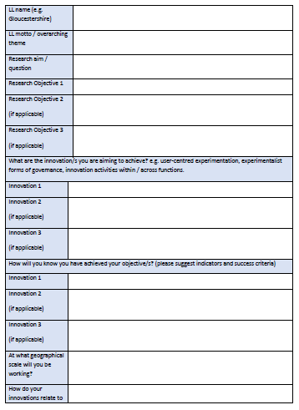
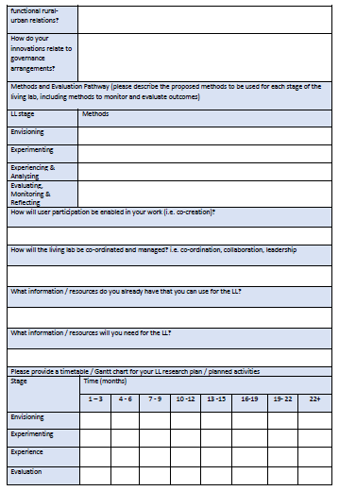
Research and Innovation Agenda: template

Slide 23
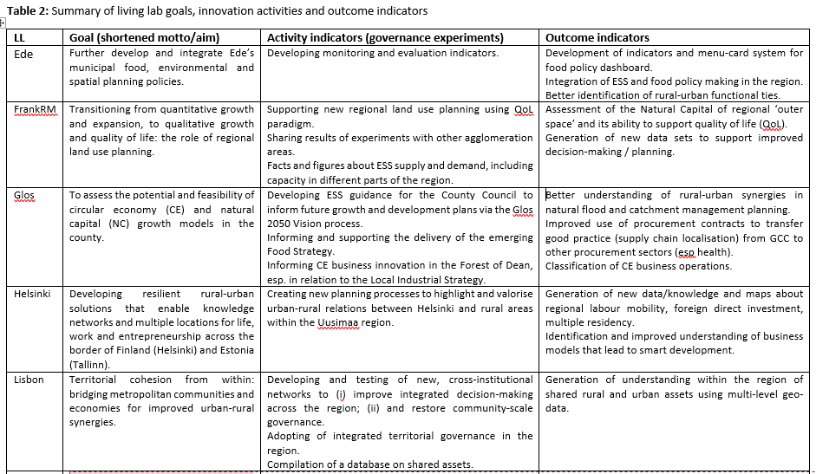
Notes:
Living lab teams will need to keep a good record of their LL processes (meetings, work shadowing, stakeholder mapping etc.) in order to show evidence of progress towards their intended goals. Defining the aim of the lab and key related outcomes is therefore essential to agree potential indicators.
Table 2 translates this language of evaluation to the living lab RIAs for ROBUST, giving an overview per lab of their motto/themes, governance experiments (activity indicators) and intended outcomes (outcome indicators). The logic is that governance experiments are the levers of change that enable better governance, smart development and rural-urban synergies, although we need to further scrutinise the activities and indicators that enable rural-urban synergy (and also growth). For now they reflect what we could extract from the RIAs.

